Slide 1
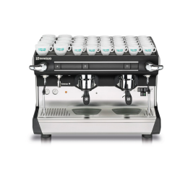


Daily Coffee Machine
Cleaning routine
Classe 5 Model S 2 & 3 groupS

Slide 2

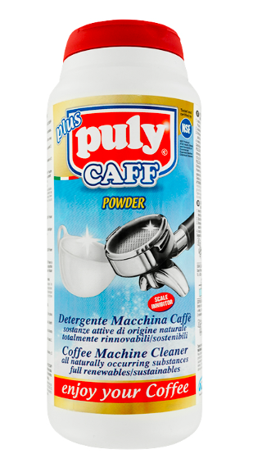
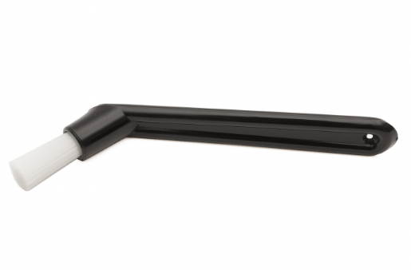

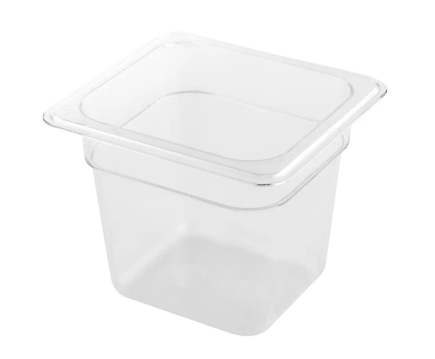
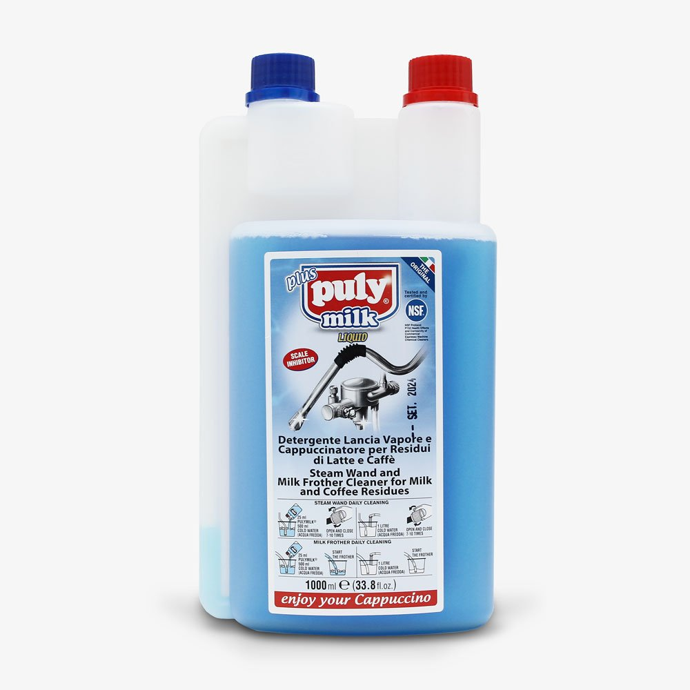
Material
Blind filter
Portafilter
Cleaning brush
Cleaning powder
Sponge
Container
Steamer cleaning

Slide 3

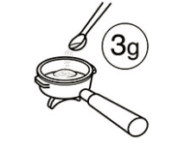
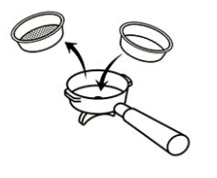
Automatic Cleaning Process
Place 3gr (half a tea spoon) of the cleaning detergent in the portafilter
Replace the normal filter with the ‘’blind’’ filter (no holes)

Slide 4

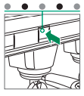

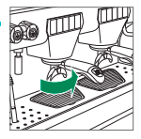

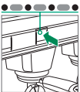
Hold start/stop dispensing but for at least 5 seconds
Shows the blinking of the LED
Lock the portafilter into group head
Activate the cleaning phase
The cycle will automatically stop

Slide 5
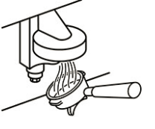
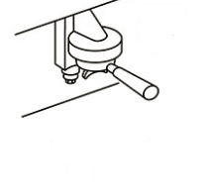


Remove portafilter and rinse it with a bit of water
Place portafilter back into group head

Slide 6
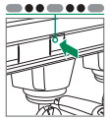

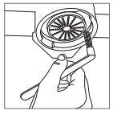
Activate the rinsing cycle
The cycle will automatically stop
Use the brush to remove coffee oils and loose grinds from the group head

Slide 7
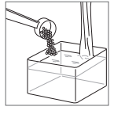
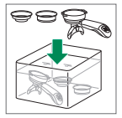
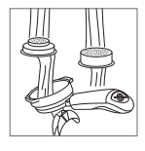
Cleaning the Portafilters
Prepare the plastic container with hot water and 6gr (1 teaspoon) of cleaning detergent
Insert portafilters separated from the filters (with holes) into the plastic container and let it sit for 10-15 minutes
After the 10-15 minutes rinse everything under running water.
Use the yellow part of the sponge to remove coffee oils and loose grinds

Slide 8
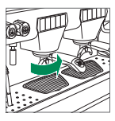
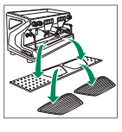
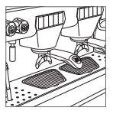
Reattach portafilter and lock the portafilter back into the group head
Remove cup holder grid and clean drain outlet.
Reattach cup holder grid

Slide 9
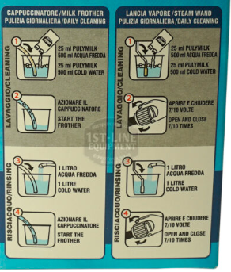
Cleaning the steamer wand and milk frother
Follow the instructions in the back of the milk detergent

Slide 10
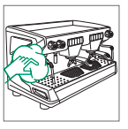
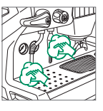
Finish with cleaning the outside
Clean the machine with a damp cloth to remove stains

